Slide 1








Business consultancy based on the barter system
Presented by Group 61
Project supervisor - Dr. Praveen Lalwani(SCSE)
Project Reviewers:
Dr. V Pandimurugan(SCSE)
Dr. Prashant G K(SMEC)

Slide 2



GROUP MEMBERS
Naman Arora - 19MIM10057
Shikhar Pandey - 19BCE10016
Vedant Agrawal - 19BCE10057
Shreyash Singh - 19BCY10066
Patnala Saikiran - 19BCY10103
Shivam Agrawal - 19BCY10140
Krishna Agrawal - 19BCY10177
Mayank Nath Tiwary - 19BME10034

Slide 3




Introduction
Bartering is a system of exchange of some goods or services with other goods, where no money is involved.
The barter system app is the android app to help people to exchange good or services easily.

Slide 4



Objective
There are many situations where people have goods or services to exchange but no money to buy things.
The objective of the android app is to make bartering easier and more efficient.
Barter could sometimes help people in some emergency situations too.

Slide 5





Background/Existing work
HISTORY
GENERAL OVERVIEW
The barter system of exchange of goods was prevalent in ancient India from the Vedic period. The Indus valley people may have used precious metals of fixed weights such as silver for buying goods which is evident from excavations in the DK area at Mohenjo-Daro.
There are some apps/websites like TradeMade, Freecycle, LetGo, etc. But the problem is that is not known to people.

Slide 6
Advantages and Disadvantages of Barter
ADVANTAGES
DISADVANTAGES
Double coincidence of wants.
Lack of common measure of value.
Difficulty in deferring payments.
Indivisibility of goods.
No storage of value.
Simplicity.
No real concentration of power.
No overexploitation of natural resources.

Slide 7





Project Module
Modules provide a container for the app's source code, resource files, and app-level settings, such as the module-level build file and Android manifest file.
We will be using the application module in our application
An application module is a class that represents a business application task. •It encapsulates the data model associated with a task, plus the custom code to implement the task.

Slide 8







Outcome
•It will allow individuals to trade items that they own but are not using for items that they need.
•It will be helpful for various NGOs where people donate their personal belongings instead of money and they can trade it for whatever they need.
•It can help people to save money as well.

Slide 9
Responsibilities of each member
We had planned out activity in such a way that each member of the group have done equal amount of work.
We divided our group into the 3 teams and each team had to some work and when combined we have result as the barter system app.

Slide 10
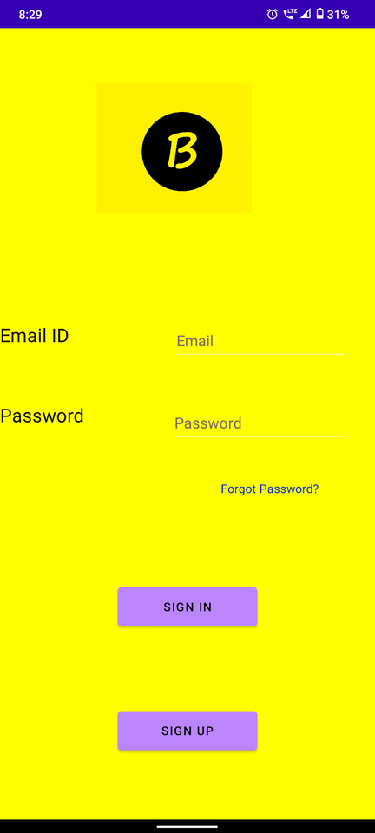
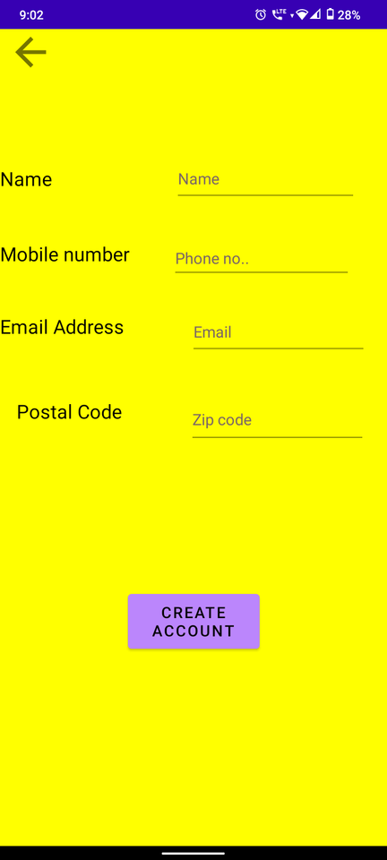
Snapshots of the Project

Slide 11
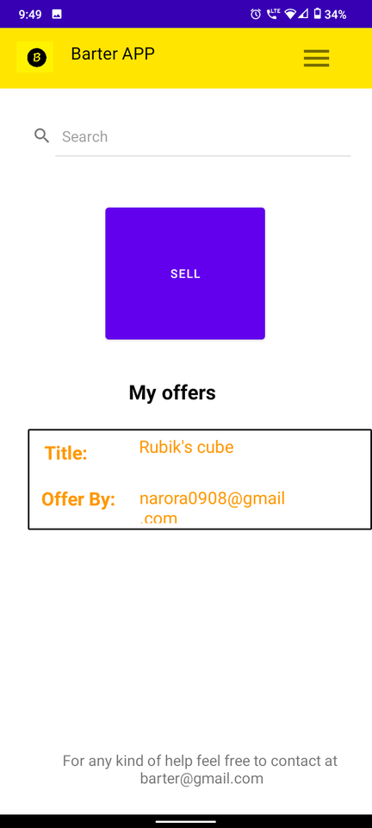
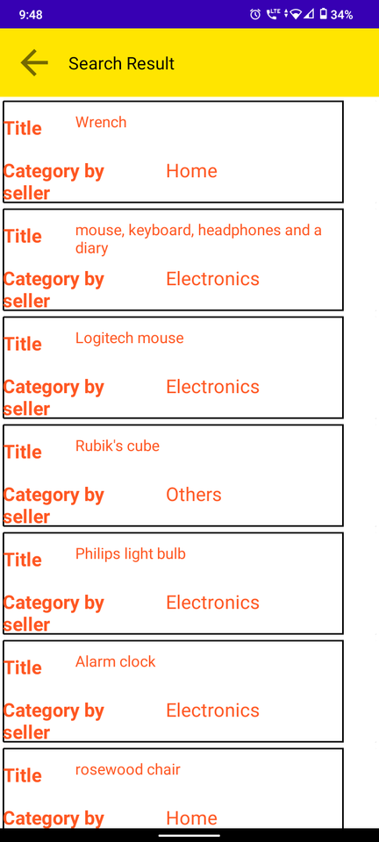
Snapshots of the Project

Slide 12
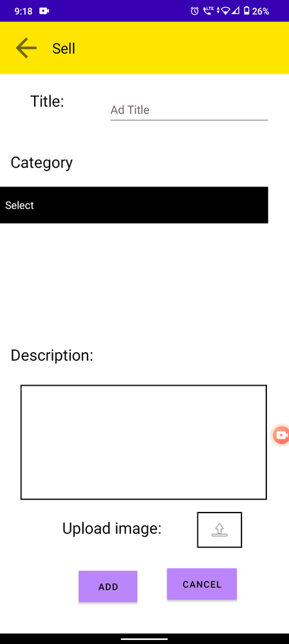
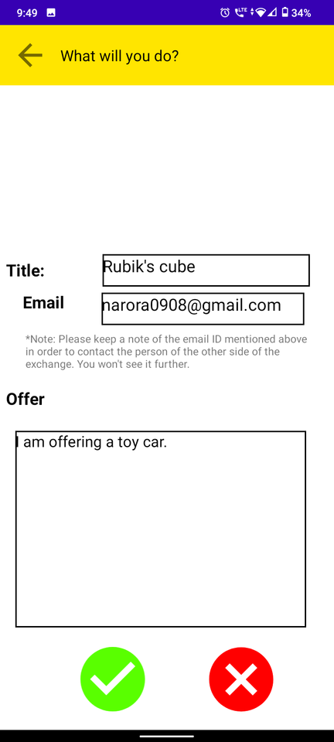
Snapshots of the Project

Slide 13

GitHub Link
https://github.com/namanarora09/Barter-System-APP

Slide 14
3 Best Apps + Websites for Trading, Bartering & Swapping Stuff | TradeMade, Inc. 2020 | A Trade & Barter App, With A Cause (trademade-app.com)
What Is Barter? - Definition, Characteristics, Pros & Cons (feedough.com)
Reference

Slide 15

Thank
You

